Slide 1
SingleLinkage Clustering: The Algorithm
Lecture Four

Slide 2
Example
Let’s now see a simple example: a hierarchical clustering of distances in kilometers between some Italian cities.
The method used is singlelinkage.
Input distance matrix (L = 0 for all the clusters):

Slide 3
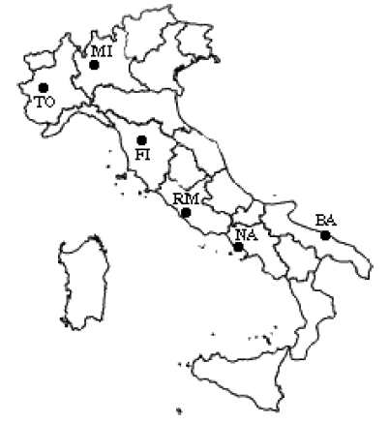
Step 1

Slide 4
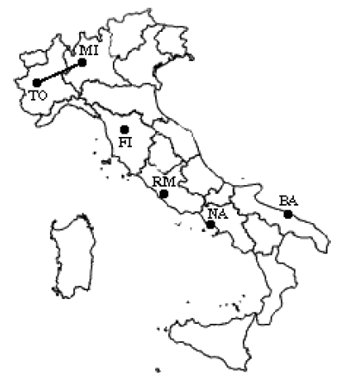
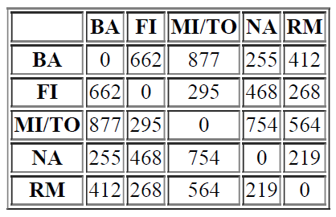
Step 2

Slide 5
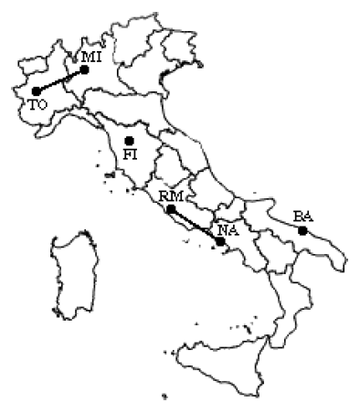
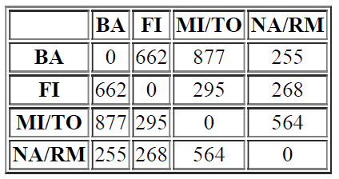
Step 3

Slide 6
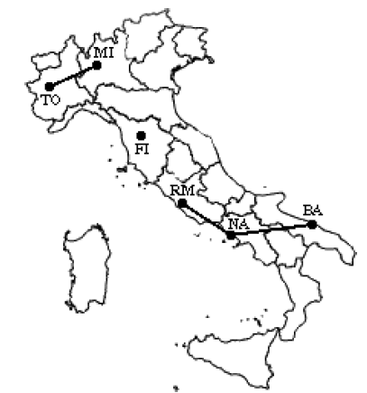
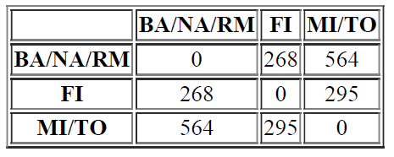
Step 4

Slide 7
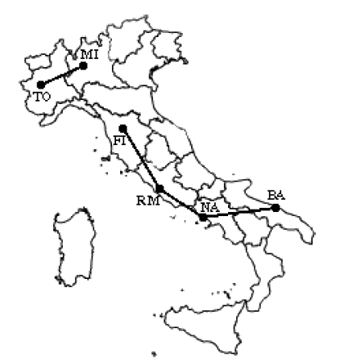
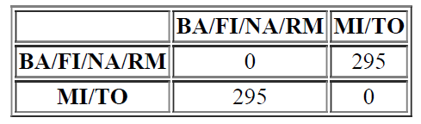
Step 5

Slide 8
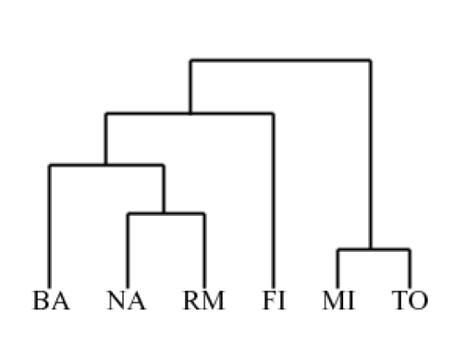
Final

Slide 9
Biological Example

Slide 10
Biological Example (Cont.)

Slide 11
Biological Example (Cont.)

